Slide 1
Evaluating performance of models
Birk Nøhr Dissing

Slide 2
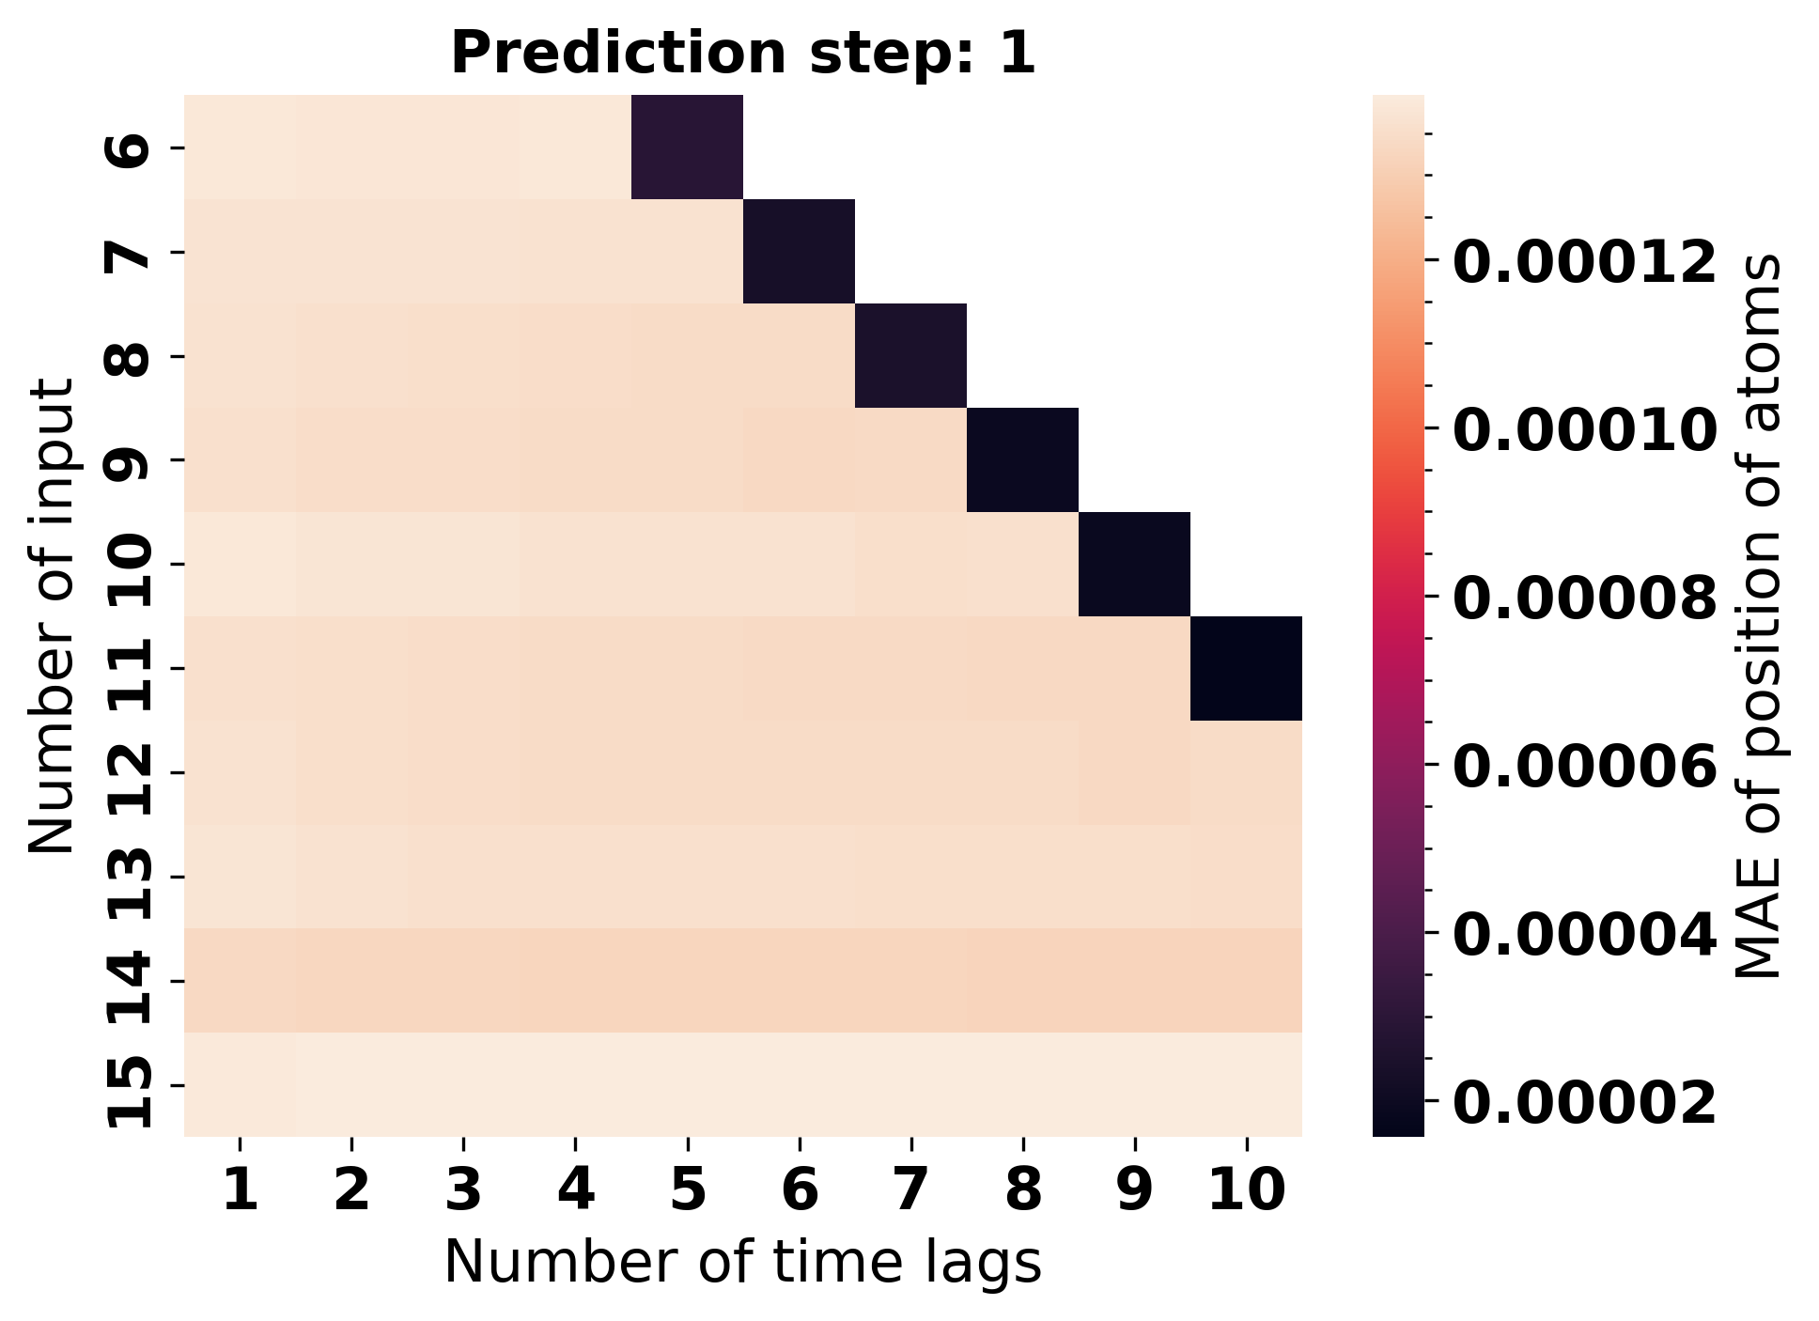

Slide 3
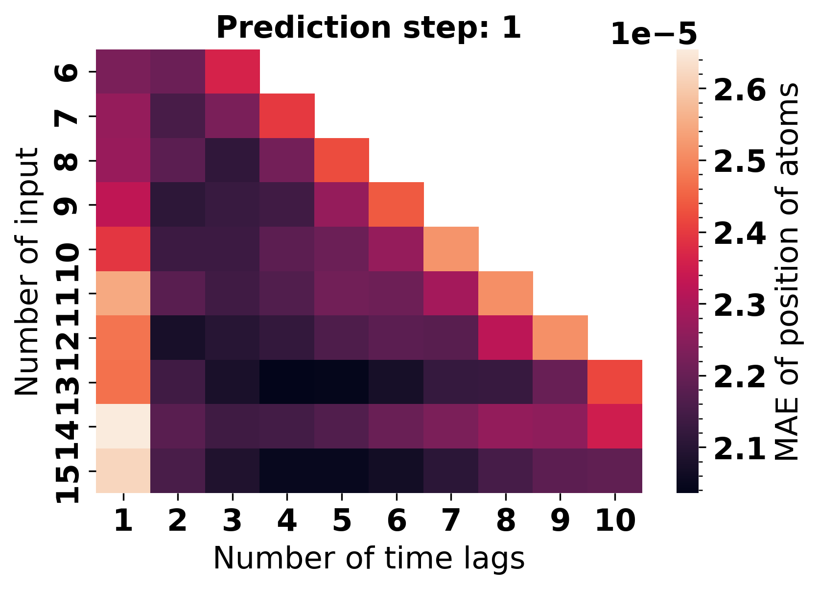
Hyperparameter optimization

Slide 4
Angles KS score summary
file | min KS | max KS | mean KS | std KS | Relative STD
SVD_regularized12_2.xyz | 0.00E+00 | 1.15E-01 | 1.19E-02 | 3.15E-02 | 3.77E-01
SVD_not_regularized13_4.xyz | 3.18E-143 | 6.71E-02 | 5.16E-03 | 1.79E-02 | 2.89E-01
SVD_not_regularized12_2.xyz | 1.90E-99 | 3.89E-02 | 5.09E-03 | 1.15E-02 | 4.42E-01
velverlet_8_0.xyz | 8.35E-178 | 3.97E-02 | 4.09E-03 | 1.08E-02 | 3.78E-01
SVD_regularized9_2.xyz | 5.97E-61 | 3.68E-02 | 3.96E-03 | 1.02E-02 | 3.87E-01
SVD_regularized8_3.xyz | 0.00E+00 | 1.68E-02 | 1.29E-03 | 4.46E-03 | 2.89E-01
SVD_regularized13_5.xyz | 1.21E-118 | 4.53E-03 | 3.50E-04 | 1.21E-03 | 2.89E-01
model_test_8_1_arima_no_constant.xyz | 1.14E-73 | 2.52E-03 | 2.29E-04 | 6.73E-04 | 3.41E-01
SVD_regularized15_5.xyz | 1.96E-93 | 2.41E-03 | 1.88E-04 | 6.42E-04 | 2.93E-01
SVD_not_regularized13_5.xyz | 7.04E-58 | 1.56E-03 | 1.24E-04 | 4.16E-04 | 2.98E-01
SVD_regularized13_4.xyz | 0.00E+00 | 4.59E-04 | 3.93E-05 | 1.22E-04 | 3.22E-01
velverlet_13_0.xyz | 1.21E-242 | 4.67E-04 | 3.69E-05 | 1.24E-04 | 2.97E-01
SVD_not_regularized8_3.xyz | 3.41E-296 | 2.46E-05 | 1.89E-06 | 6.55E-06 | 2.89E-01
model_test_8_1_AR.xyz | 7.94E-190 | 3.52E-07 | 3.01E-08 | 9.35E-08 | 3.23E-01
SVD_not_regularized15_5.xyz | 0.00E+00 | 1.24E-07 | 9.56E-09 | 3.31E-08 | 2.89E-01
SVD_not_regularized9_2.xyz | 2.79E-140 | 2.45E-08 | 1.88E-09 | 6.53E-09 | 2.89E-01

Slide 5
Bond lengths KS score summary
file | min KS | max KS | mean KS | std KS | Relative STD
SVD_not_regularized12_2.xyz | 0.00E+00 | 7.25E-02 | 9.06E-03 | 2.40E-02 | 3.78E-01
velverlet_13_0.xyz | 3.11E-304 | 4.07E-02 | 5.72E-03 | 1.33E-02 | 4.28E-01
model_test_8_1_arima_no_constant.xyz | 0.00E+00 | 1.11E-02 | 1.39E-03 | 3.67E-03 | 3.78E-01
velverlet_8_0.xyz | 0.00E+00 | 3.23E-03 | 5.06E-04 | 1.06E-03 | 4.76E-01
SVD_regularized13_5.xyz | 0.00E+00 | 1.51E-03 | 1.89E-04 | 4.99E-04 | 3.78E-01
model_test_8_1_AR.xyz | 2.83E-122 | 8.42E-04 | 1.05E-04 | 2.78E-04 | 3.78E-01
SVD_not_regularized9_2.xyz | 0.00E+00 | 2.22E-08 | 2.77E-09 | 7.34E-09 | 3.78E-01
SVD_not_regularized13_5.xyz | 1.16E-306 | 5.60E-09 | 7.01E-10 | 1.85E-09 | 3.78E-01
SVD_regularized15_5.xyz | 0.00E+00 | 1.53E-13 | 1.92E-14 | 5.06E-14 | 3.79E-01
SVD_not_regularized8_3.xyz | 0.00E+00 | 5.42E-14 | 6.78E-15 | 1.79E-14 | 3.78E-01
SVD_regularized13_4.xyz | 0.00E+00 | 2.64E-15 | 3.30E-16 | 8.73E-16 | 3.78E-01
SVD_regularized8_3.xyz | 0.00E+00 | 1.56E-17 | 1.95E-18 | 5.17E-18 | 3.78E-01
SVD_regularized12_2.xyz | 0.00E+00 | 3.84E-22 | 4.80E-23 | 1.27E-22 | 3.78E-01
SVD_not_regularized13_4.xyz | 0.00E+00 | 5.24E-26 | 1.13E-26 | 1.99E-26 | 5.68E-01
SVD_regularized9_2.xyz | 4.46E-138 | 2.06E-28 | 2.59E-29 | 6.81E-29 | 3.80E-01
SVD_not_regularized15_5.xyz | 0.00E+00 | 1.70E-50 | 2.77E-51 | 5.65E-51 | 4.91E-01

Slide 6
Best performing models
Lstsq (VAR) |  | Angles |  |  |  | Bonds
Input | Max lag | Min KS | Max KS | Mean KS | Std | Min KS | Max KS | Mean KS | Std
12 | 2 | 1.90E-99 | 3.89E-02 | 5.09E-03 | 1.15E-02 | 0.00E+00 | 7.25E-02 | 9.06E-03 | 2.40E-02
12 | 2 | 3.84E-78 | 5.84E-02 | 5.30E-03 | 1.55E-02 | 8.01E-222 | 8.19E-06 | 1.02E-06 | 2.71E-06
Regularized Lstsq (VAR)
13 | 5 | 1.21E-118 | 4.53E-03 | 3.50E-04 | 1.21E-03 | 0.00E+00 | 1.51E-03 | 1.89E-04 | 4.99E-04
13 | 5 | 5.64E-180 | 8.65E-07 | 8.78E-08 | 2.30E-07 | 0.00E+00 | 1.18E-24 | 1.47E-25 | 3.89E-25
ARIMA (AR)
8 | 2 | 1.14E-73 | 2.52E-03 | 2.29E-04 | 6.73E-04 | 0.00E+00 | 1.11E-02 | 1.39E-03 | 3.67E-03
Lstsq (AR)
8 | 2 | 7.94E-190 | 3.52E-07 | 3.01E-08 | 9.35E-08 | 2.83E-122 | 8.42E-04 | 1.05E-04 | 2.78E-04
VelVerlet
8 | N/A | 1.21E-242 | 4.67E-04 | 3.69E-05 | 1.24E-04 | 3.11E-304 | 4.07E-02 | 5.72E-03 | 1.33E-02
Reference
N/A | N/A | 1.08E-227 | 1.49E-01 | 1.15E-02 | 3.97E-02 | 0.00E+00 | 9.27E-05 | 1.16E-05 | 3.07E-05

Slide 7
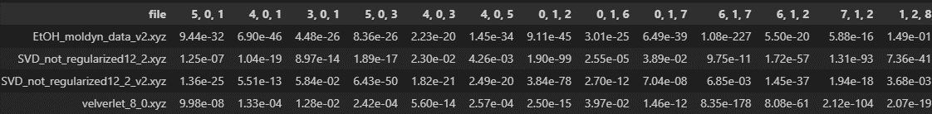
Comparing KS for velverlet and model at all angles
H-C-C
H-C-H
C-C-O
C-C-H
H-C-H
H-C-O
C-O-H

Slide 8
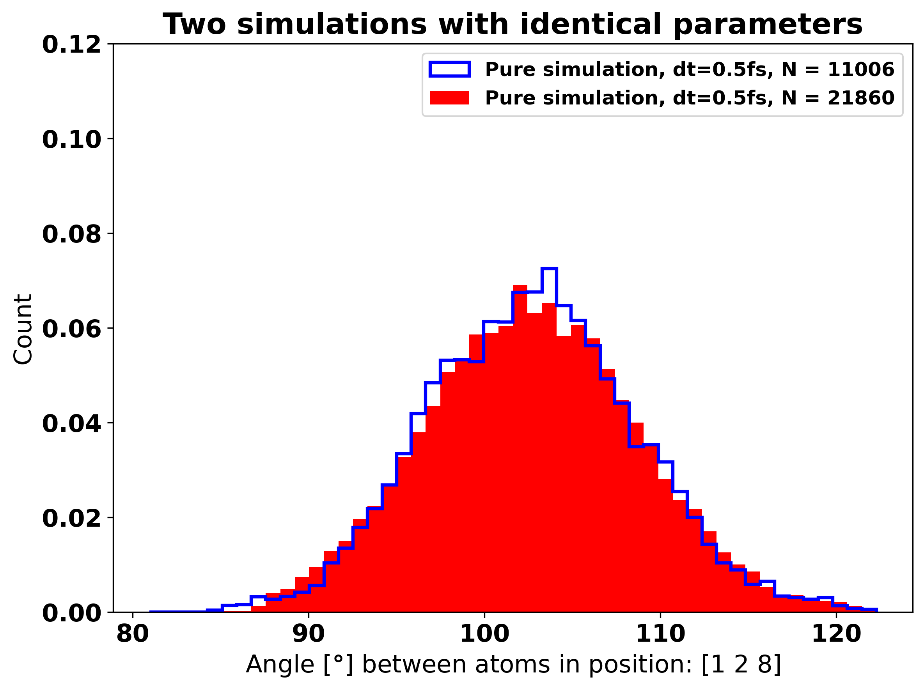
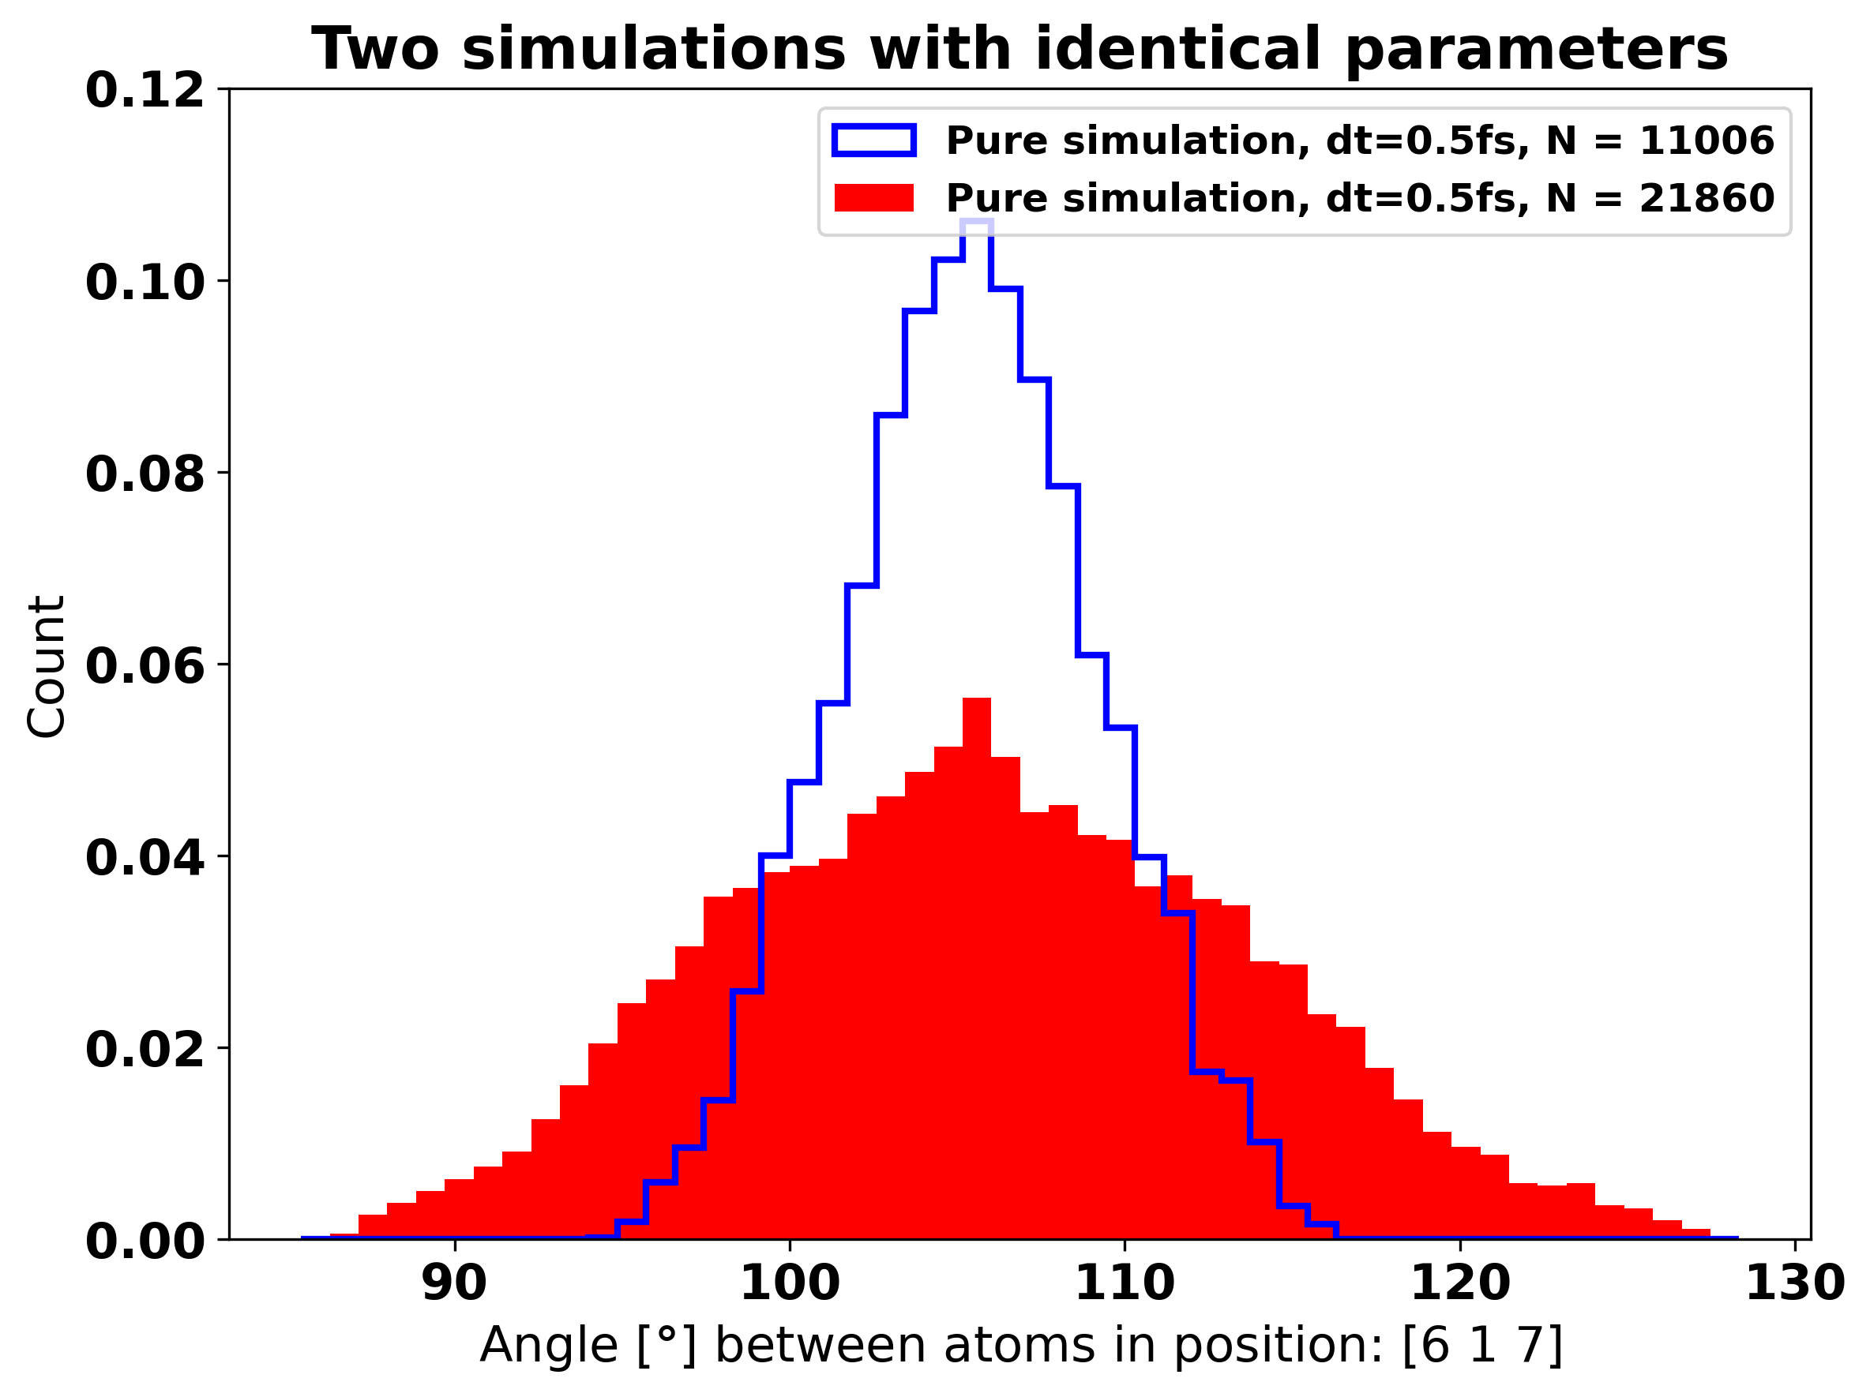
Highest KS score, 1.49e-1
Angles
Two simulations with identical parameters
Lowest KS score,
1..08e-277

Slide 9
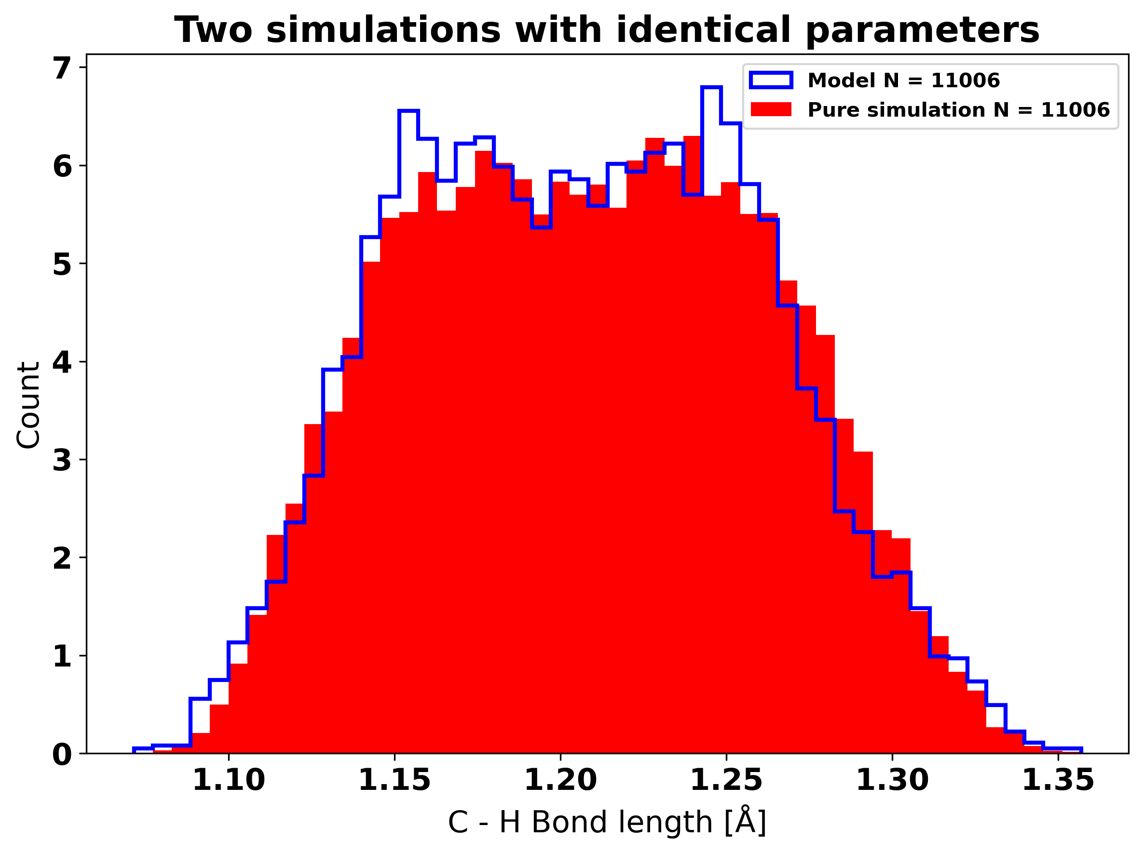
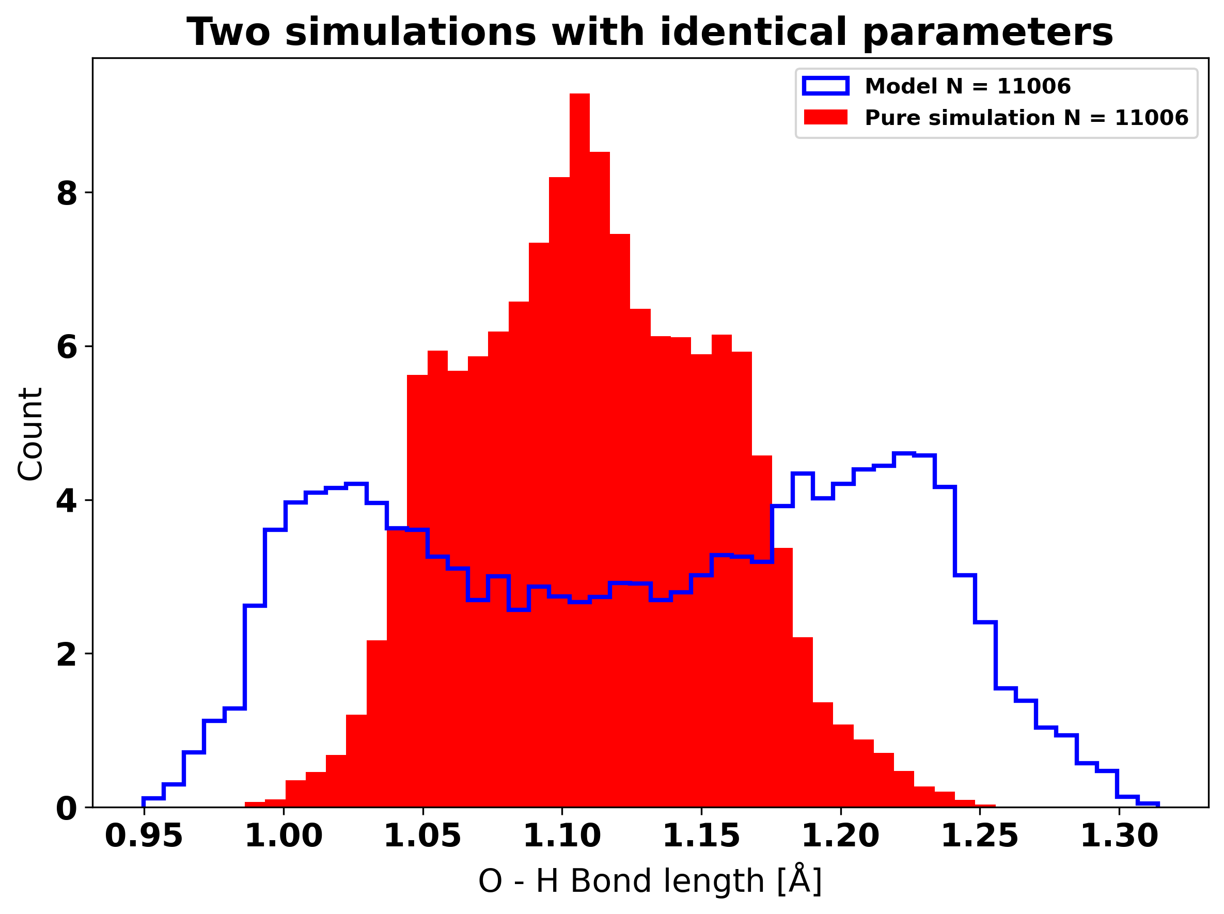
Highest KS score, 9.27e-2
Bonds
Two simulations with identical parameters
Lowest KS score,
0.00e+0

Slide 10
Conclusions
Seems that angle and bond lengths are not a good way to compare trajectories
Looked into alternatives
Vibrational spectra
RMSD
Conformational isomer rates

Slide 11
Vibrational spectra (VMD)
Calculate using VMD’s IR spectral density calculator
Needs a partial charge mapping
Calculate Wannier Centers
Wannier90
Has an integration with gpaw.
ASE
Seems to not work with single-point calculators.
Unsure about the procedure
Downloading and using Wannier90
Saving Wannier centers in a formation usable for VMD
Does it only need Wannier centers for one timestep or all.

Slide 12
Align trajectory
To calculate RMSD and conformational isomer rates the trajectory needs to be aligned
VMD can do this using the method outlined by Kabsch(1978)
It’s tedious, at least without scripting
Tried to create python script to align
Based on VMD source code (measure_fit function in measure C) and Kabsch(1978)
Problem with rotation

Slide 13
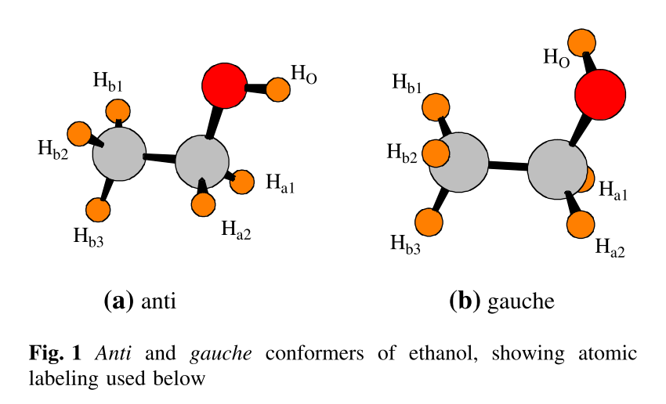
Conformational isomer rates
Ethanol has a 42:58 gauche:anti mixture
R. A. Shaw et al. (1990)
Two methods of evaluation
Compare the direction of the O-H vector with the C-C vector
Find example positions for each isomer and calculate the RMSD. The molecule is in the conformation with the lowest RMSD.
Scheiner et al. (2007)
DOI: 10.1007/s11224-008-9395-7

Slide 14
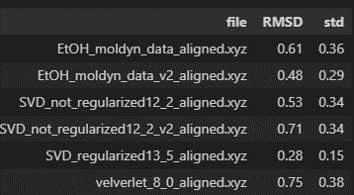
RMSD

Slide 15
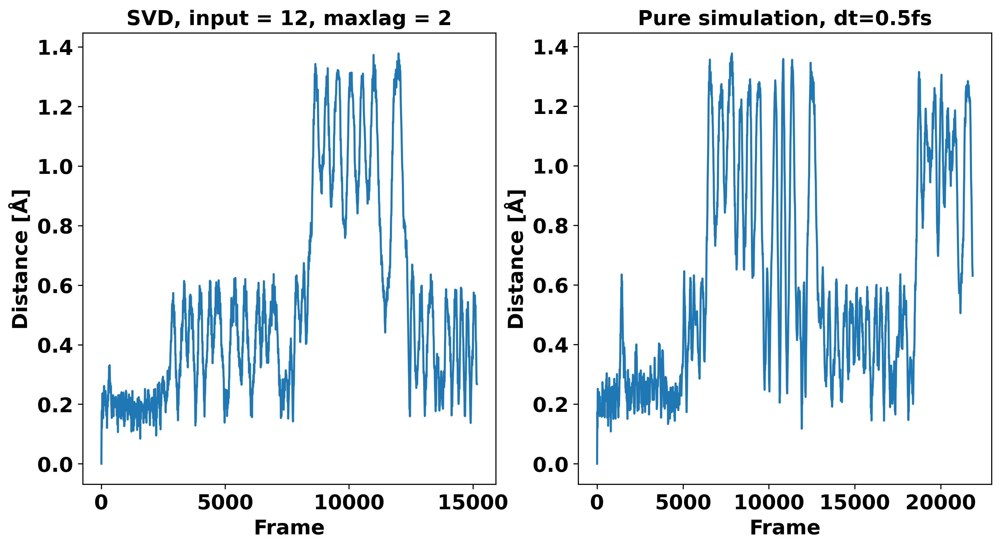
RMSD

Slide 16
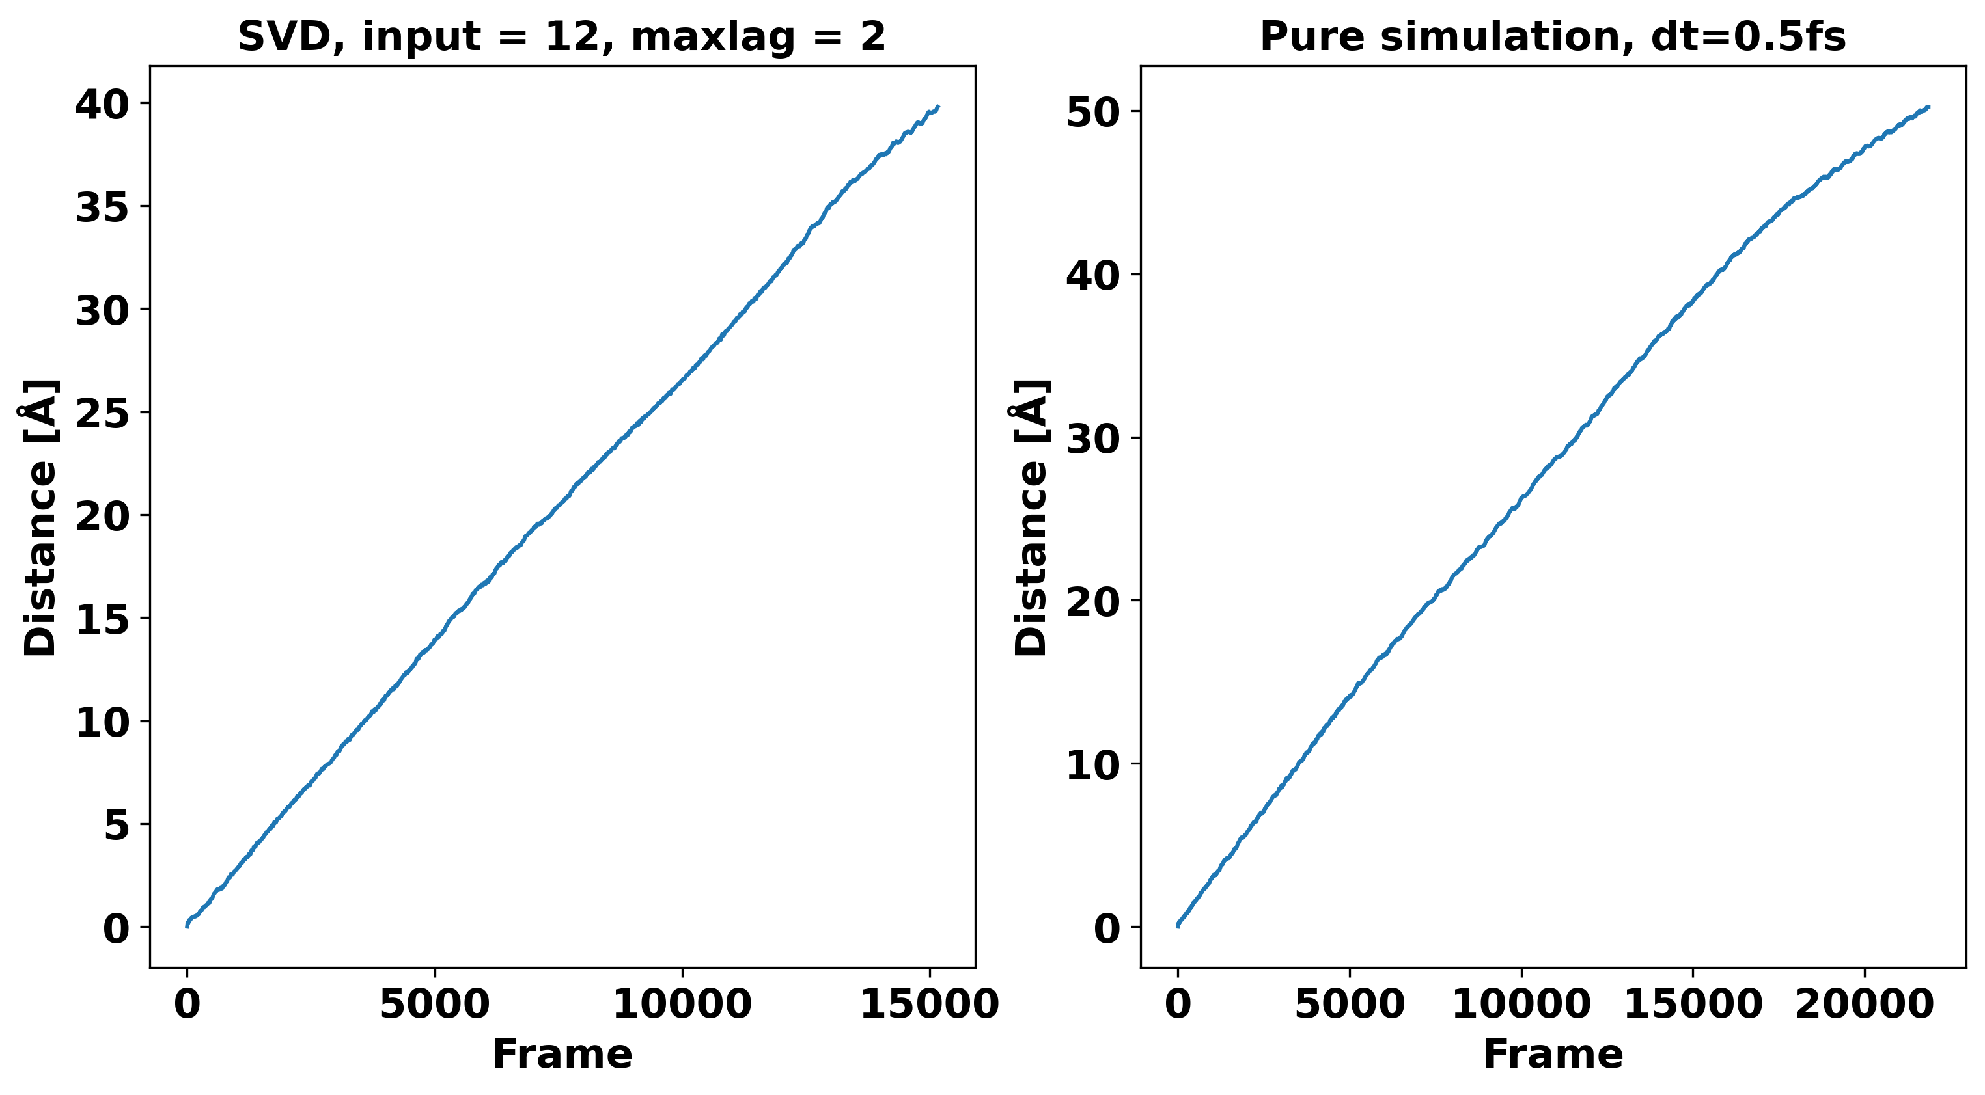

Slide 17
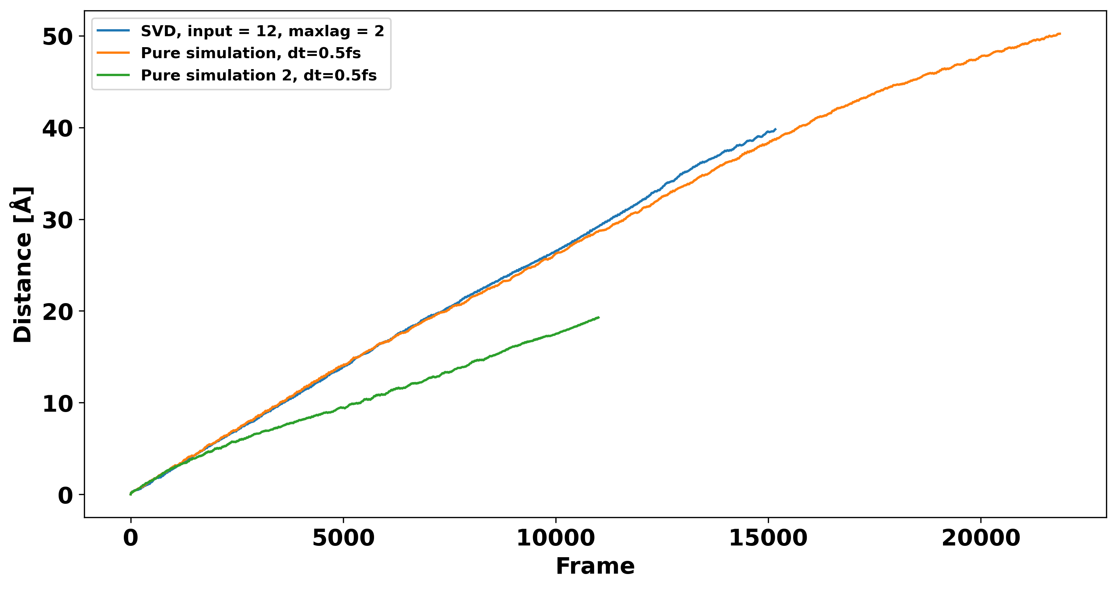

Slide 18
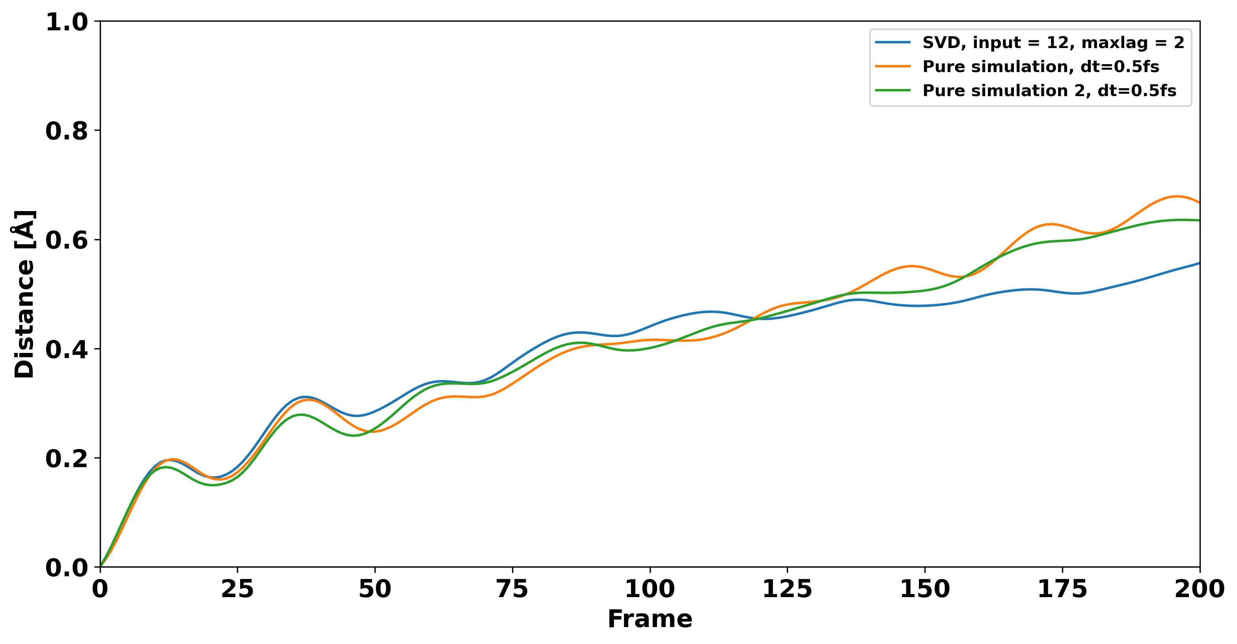

Slide 19
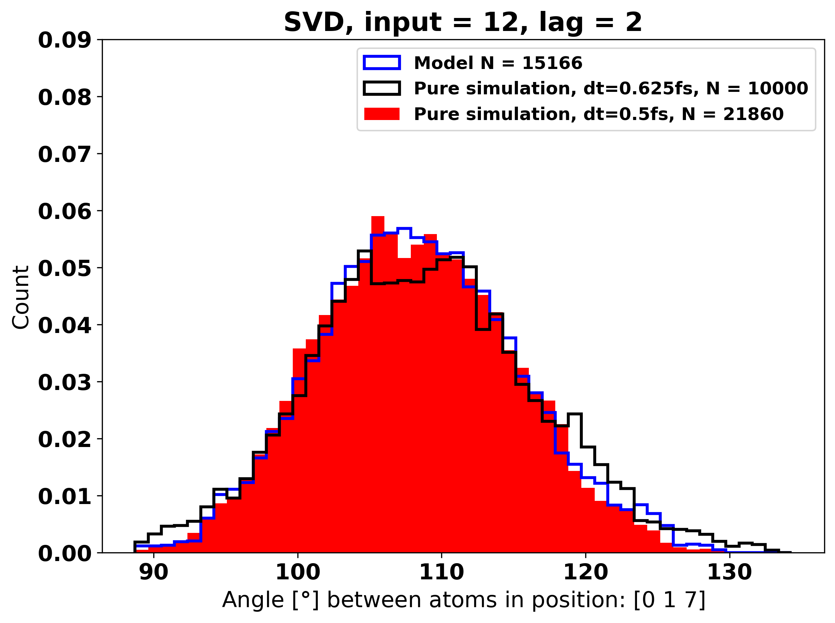
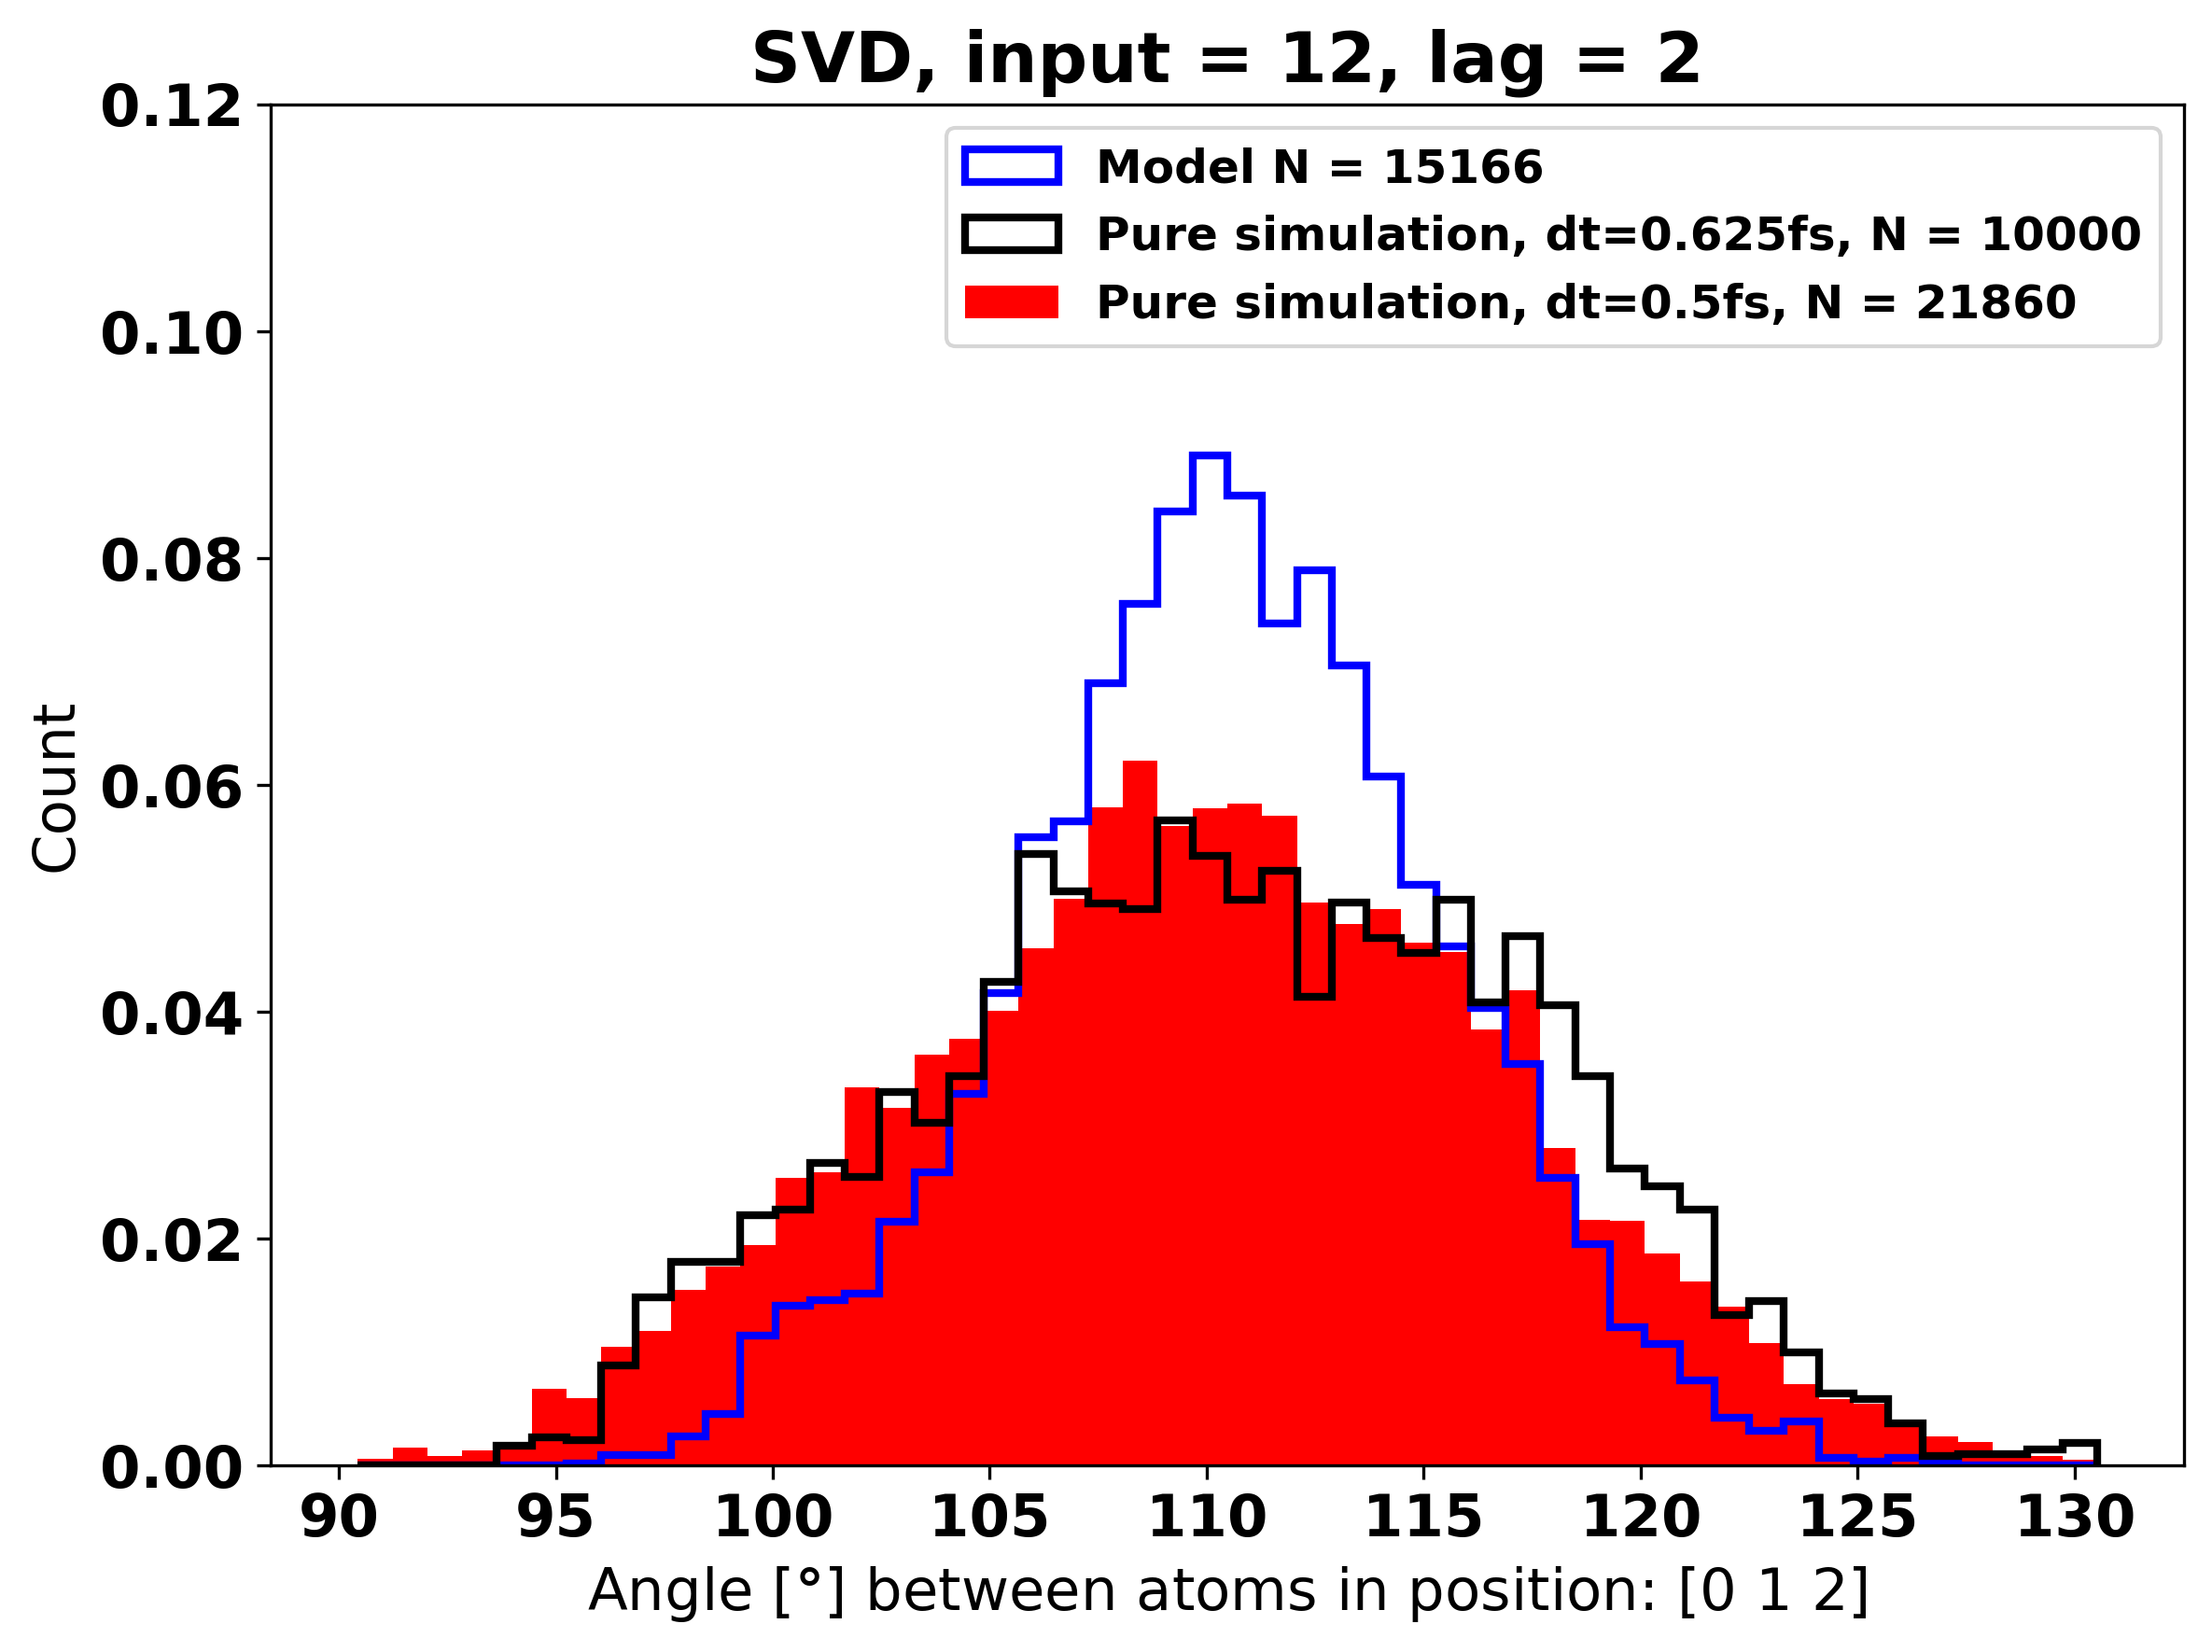
Highest KS score, 3.88e-2
Input = 12, max_lag = 2, performance on angles
Lowest KS score,
1.9e-99

Slide 20
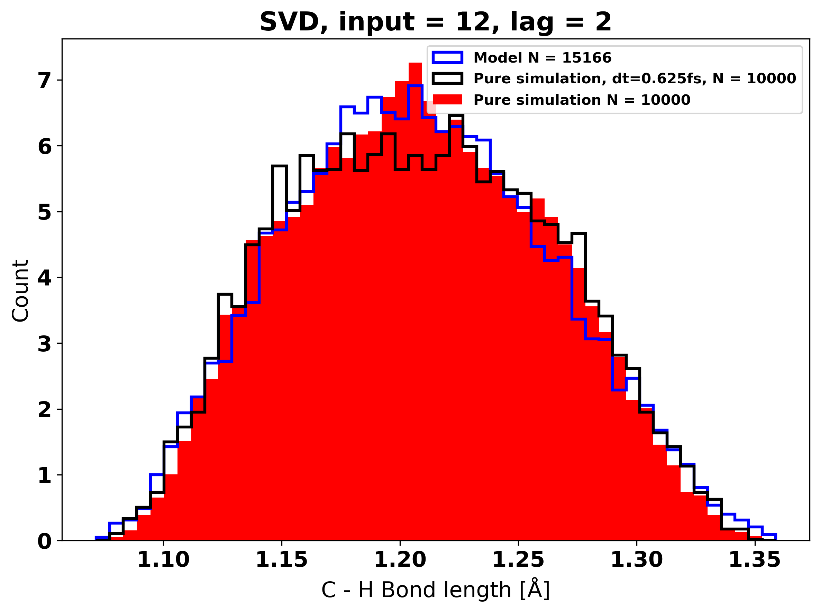
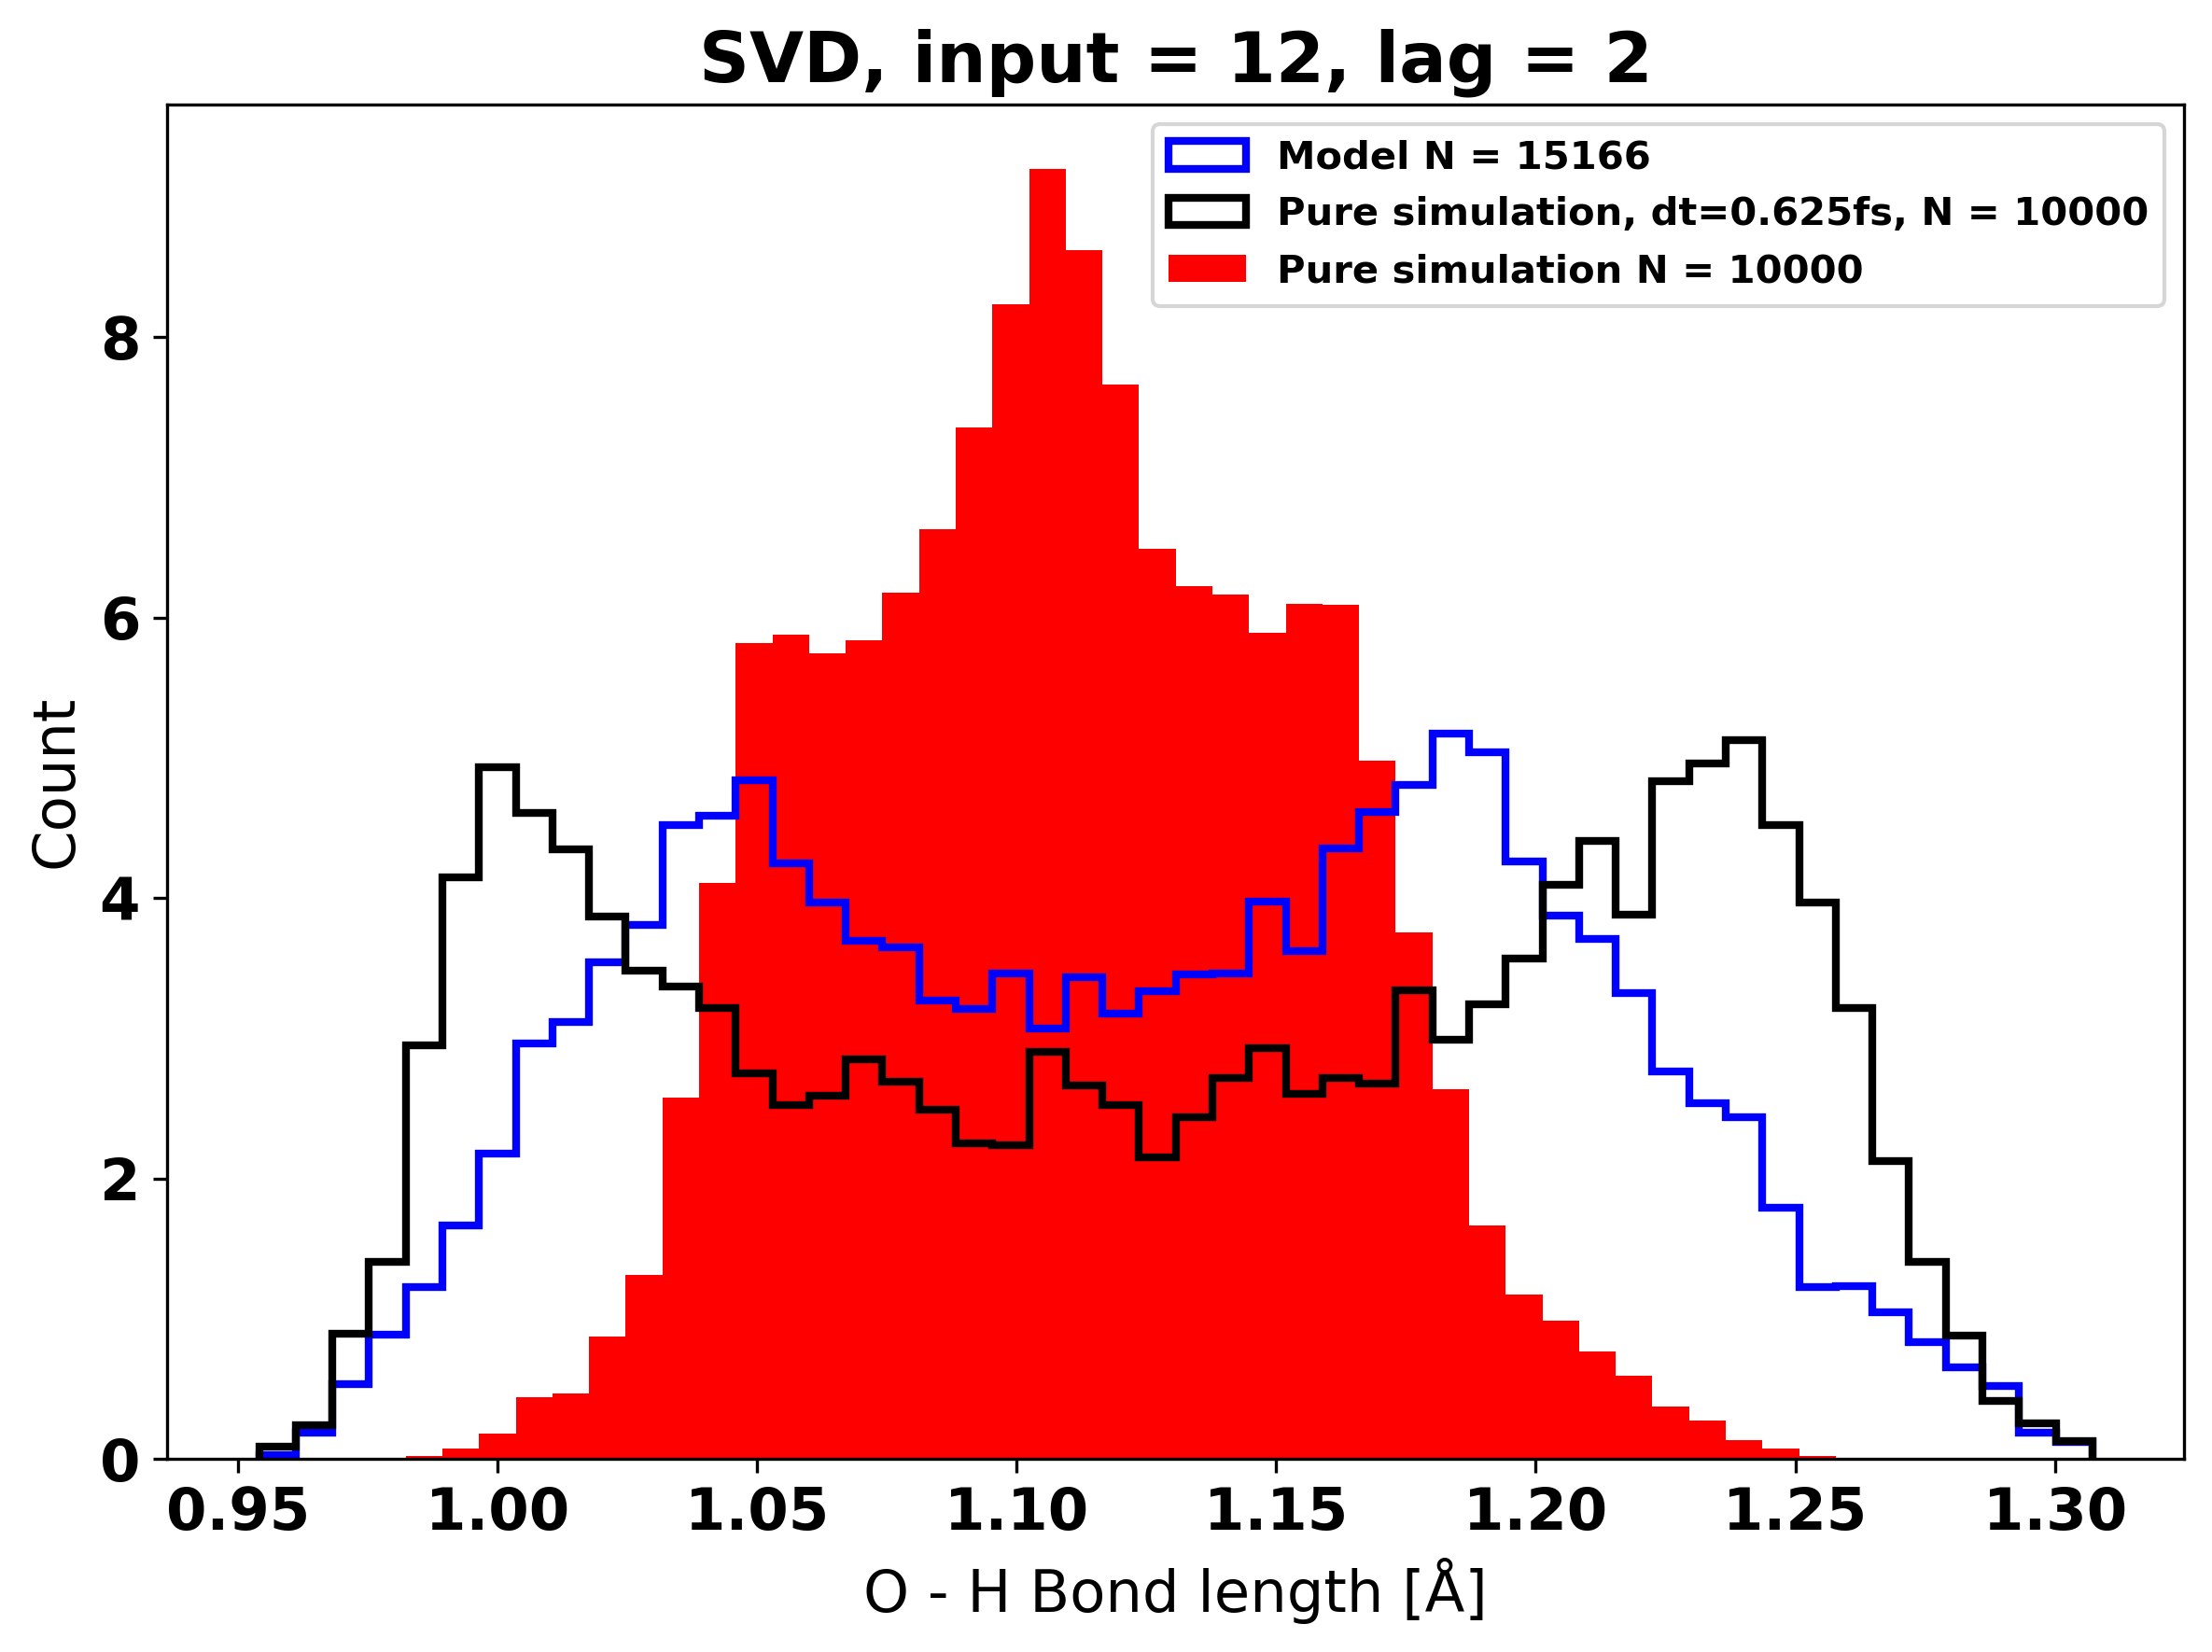
Highest KS score, 7.25e-2
Input = 12, max_lag = 2, performance on bond lengths
Lowest KS score,
0.00

Slide 21
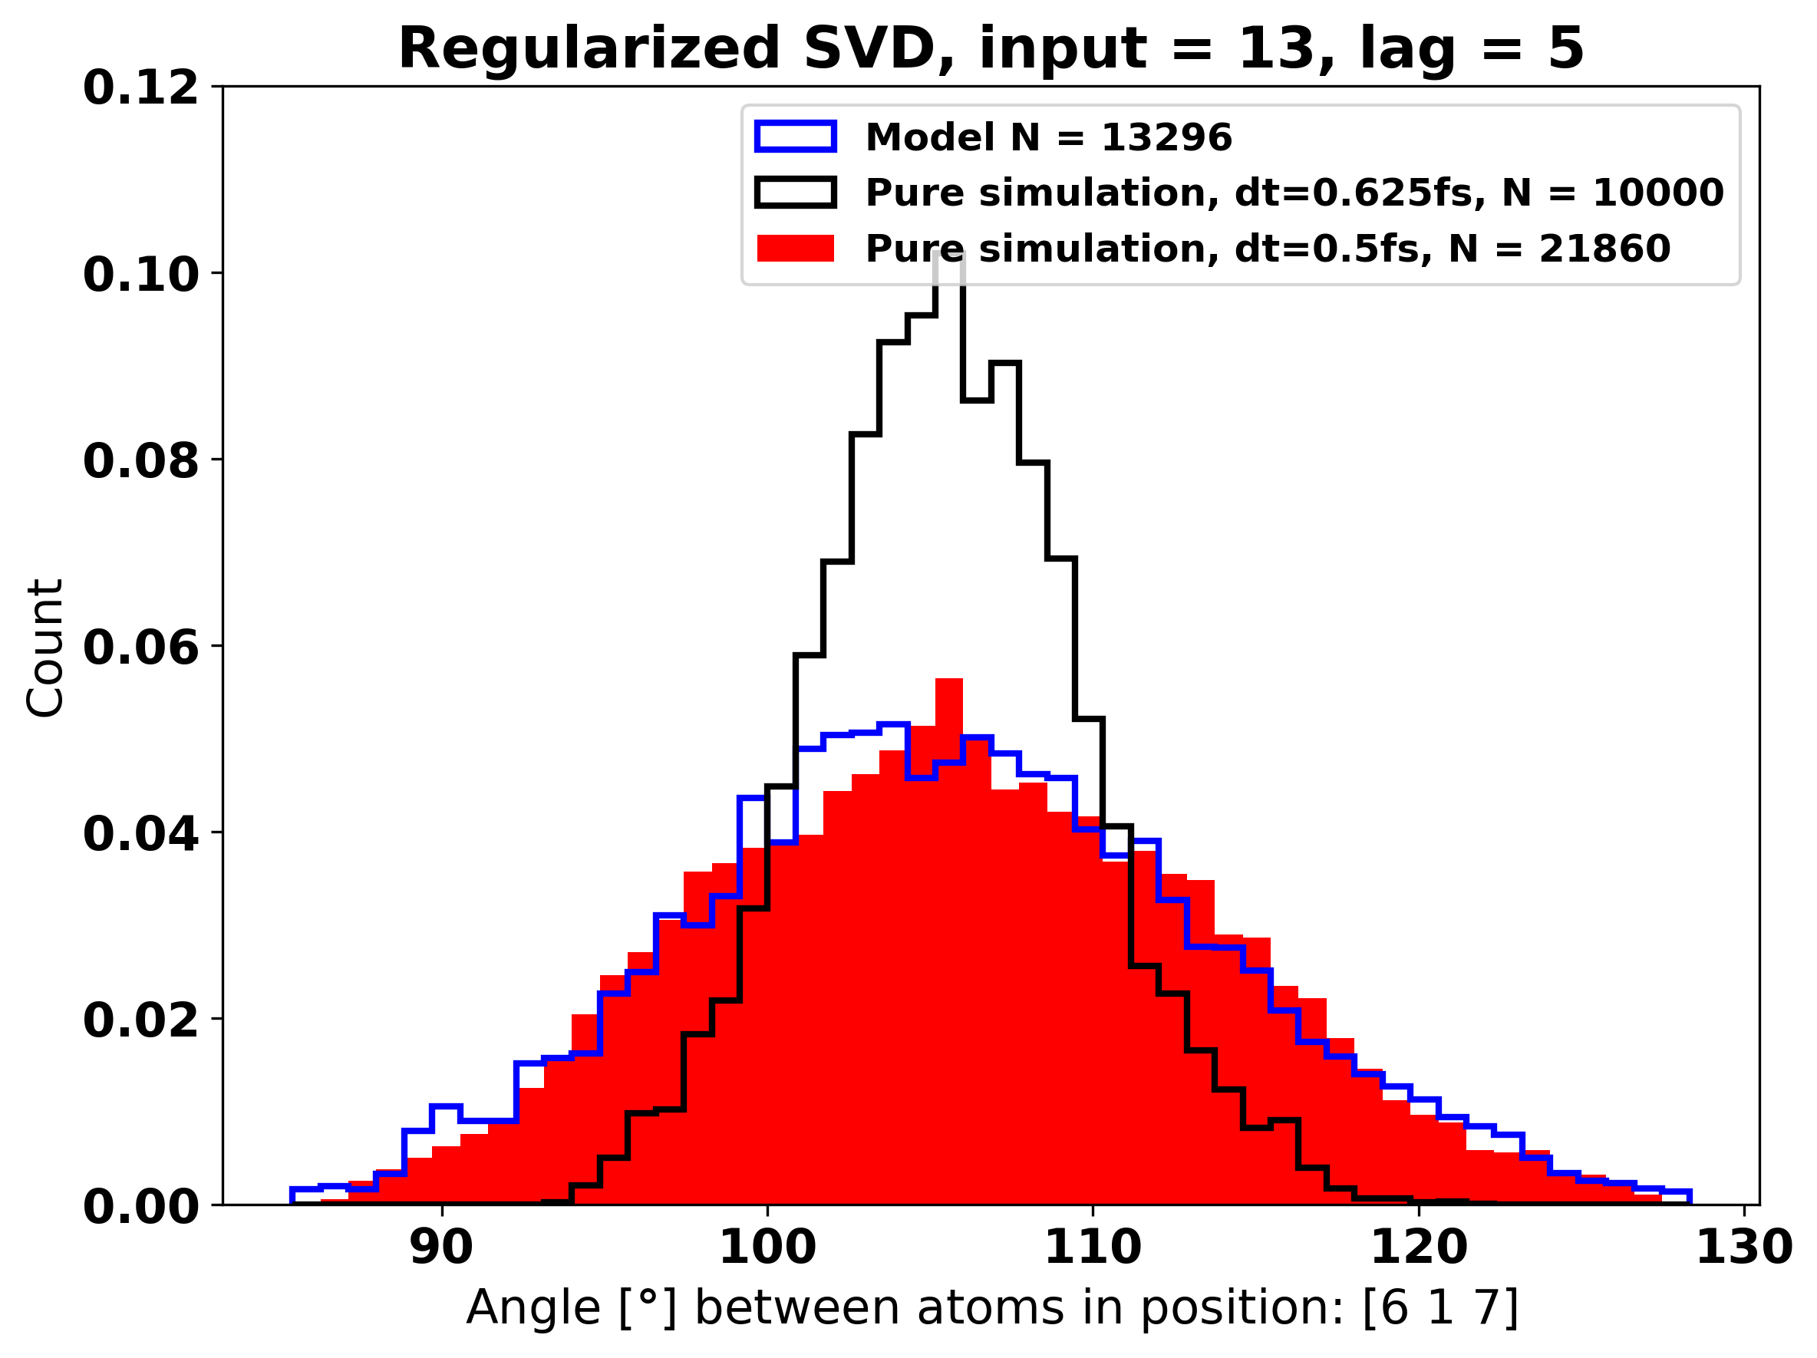
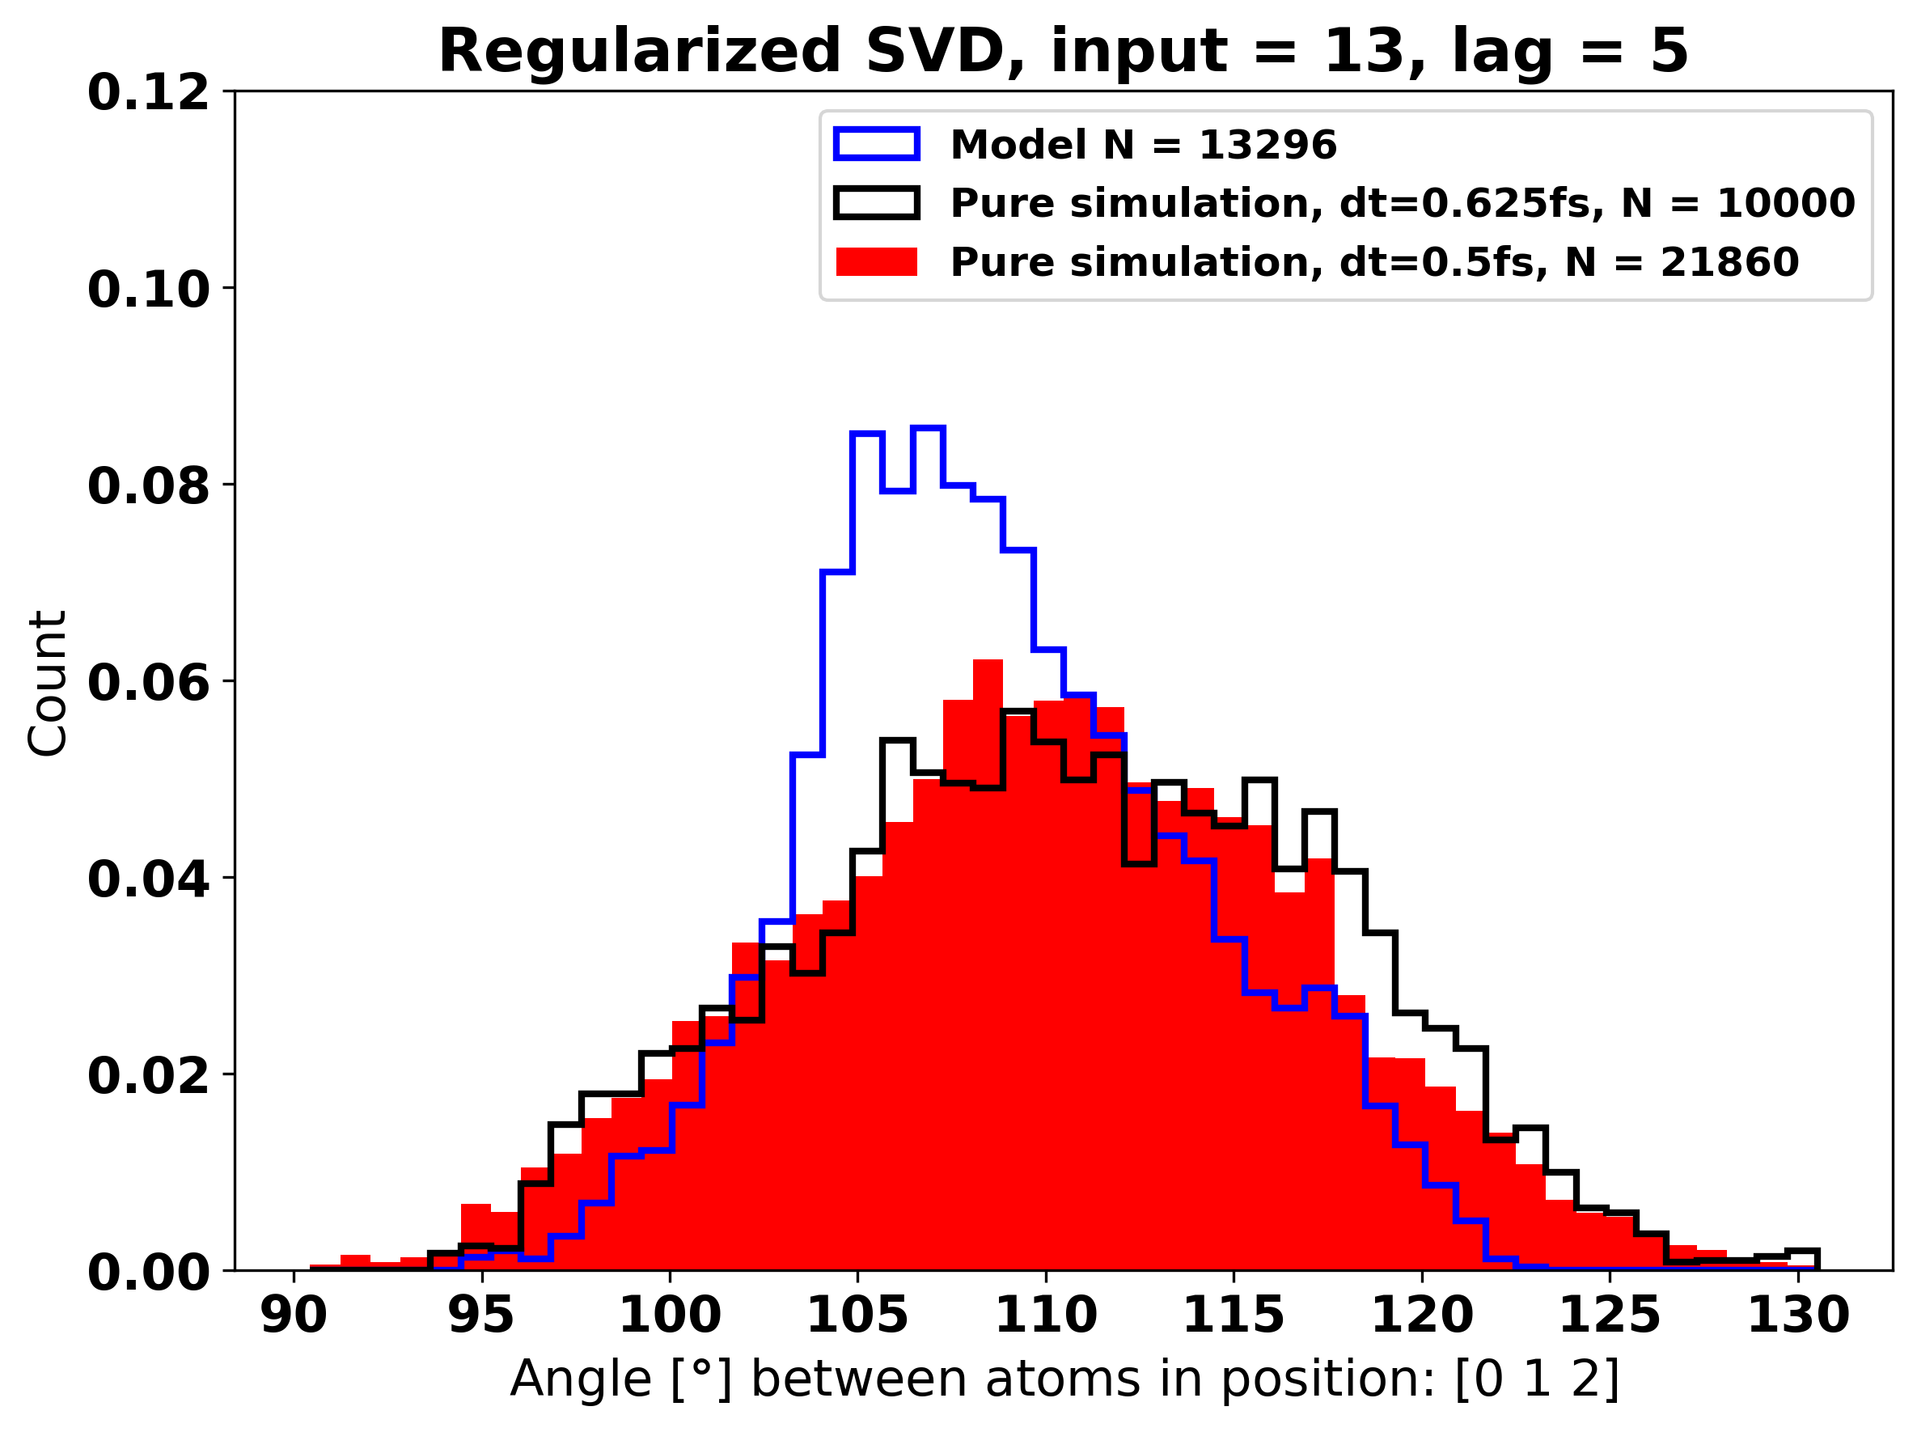
Highest KS score, 4.53e-3
Regularized input = 13, max_lag = 5, performance on angles
Lowest KS score,
1.9e-99

Slide 22
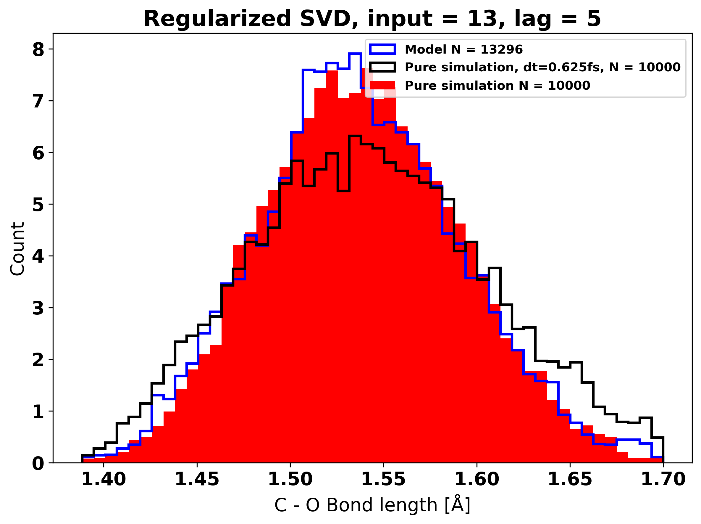
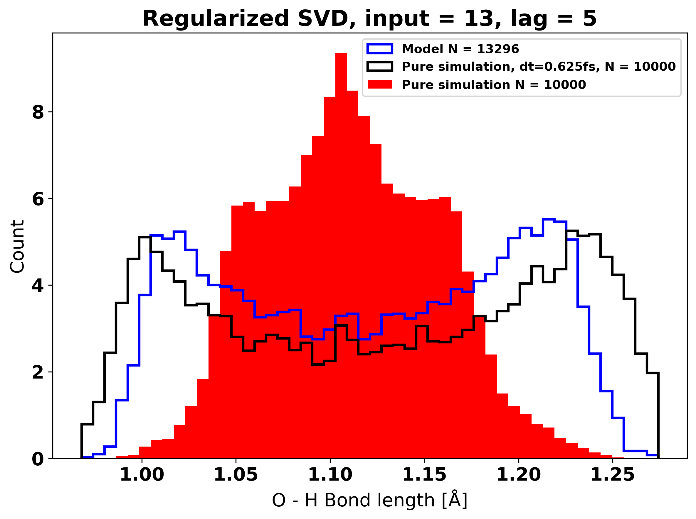
Highest KS score, 1.51e-3
Regularized input = 13, max_lag = 5, performance on bond lengths
Lowest KS score,
0.000

Slide 23
kig på hvad originale artikler har lavet
check hvad ML literatur bruger til comparison
2D dihedral

